Slide 1
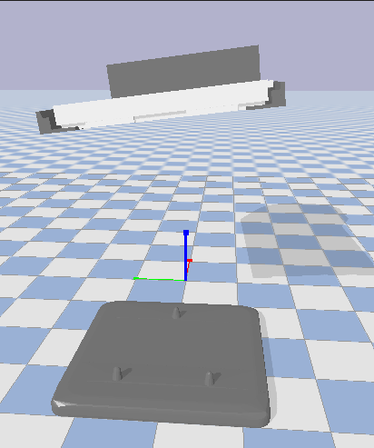
OVR/IVR Handoff Simulation
Approximate Convex Mesh Decomposition and MATLAB Simscape Collision Detection
Rohan Singh
Robotics and Mechatronics Controls Engineering Intern
Wilton, CT
Notes:
[Greeting]
My name is Rohan and today I’ll be giving a short overview of my project, OVR/IVR Handoff Simulation

Slide 2

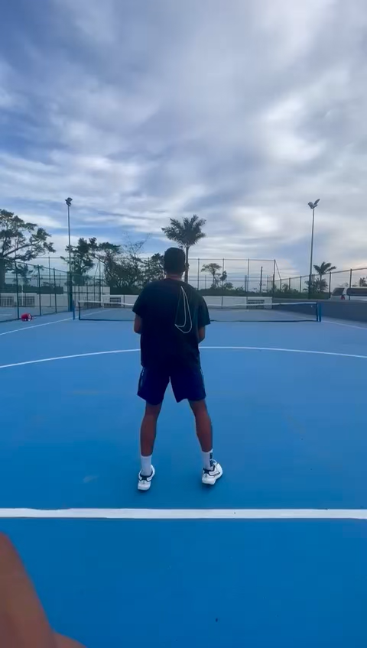

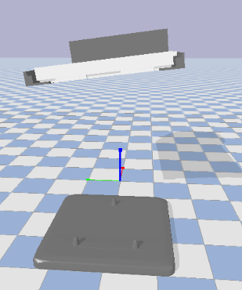
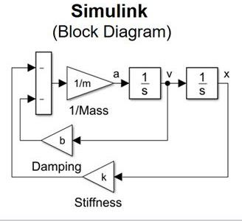

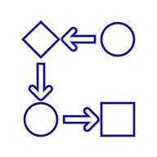
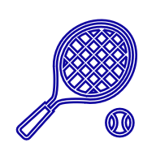
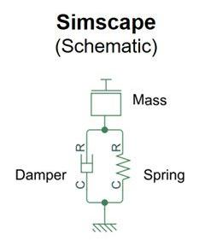
About Me
Robotics and Mechatronics Controls Engineering Intern on the Reticle Handler team
Learning how to make a physics accurate simulation in MATLAB
Rohan Singh
Master’s student at Carnegie Mellon University
Artificial Intelligence – Robotics and Control Systems
I played division 1 tennis during undergrad at Texas A&M University for 2 years
Notes:
A little about me first,
I’m currently a master’s student at Carnegie Mellon University studying artificial intelligence with a focus on Robotics and controls system.
I’m originally from Texas and did my undergrad at Texas A&M University where I studied mechanical engineering.
I’m a mechatronics intern of the reticle handler team.
A little fun fact about me, I played division 1 tennis at Texas A&M University for half my time there. I’m excited to continue learning how to make physics accurate simulations in MATLAB.

Slide 3
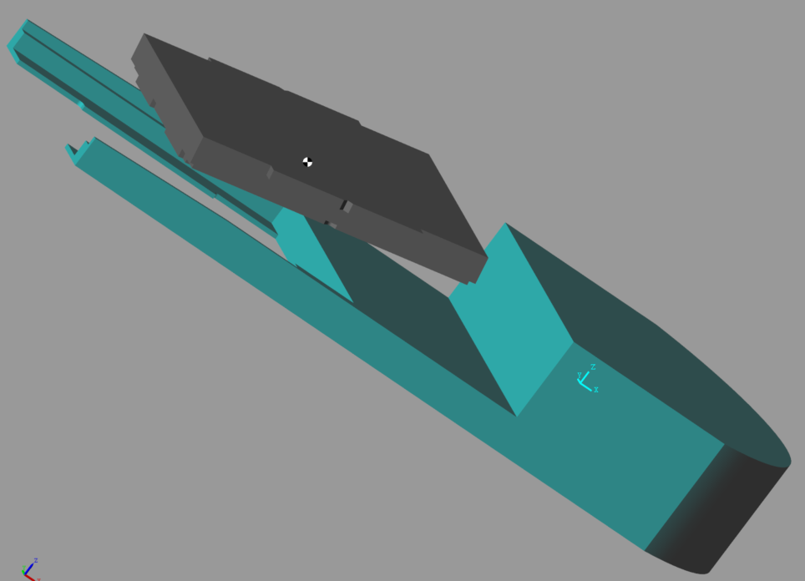
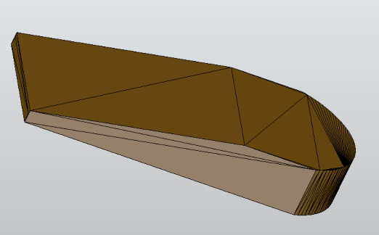
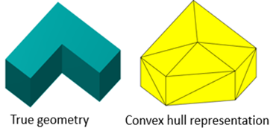
Problem Description
4
3
Precision Handoff: OVR robot aligns and grips the EIP with tight tolerances and then places it on kinematic pins.
Critical Risk: Misalignment can damage the reticle, contaminate vacuum, or halt operations.
Simulation Value: Physics-based model shows handoff complexity and margin for error.
2
1
IVR
RBI
5
December 2, 2025
Page 3
Notes:
The problem I am solving deals with the OVR robot which has the task of essentially transporting the reticle to where it needs to be.
If you direct your attention to image 4 in the top right corner you’ll see the exact situation I am modeling. The EIP, which contains the reticle, needs to directly interface with kinematic pins that are not even a millimeter wide. Image 5 in the bottom right hand corner shows two scenarios where the pins are placed correctly versus incorrectly.
Precise alignment is crucial to the success of this system which is why I am creating a simulation to pin point issues that might cause misalignment.
In order to do a physics simulation you have to be careful with how you model parts. If you turn you’re attention to image 1 you will see what most software naturally do to concave part when you simulate them. Image 3 shows an early simulation I tried to run where the EIP, the gray part, couldn’t even collide with the gripper because in reality the gripper looked like what you see in image 2. clearly this is a problem for a simulation that needs to be accurate within millimeters.

Slide 4
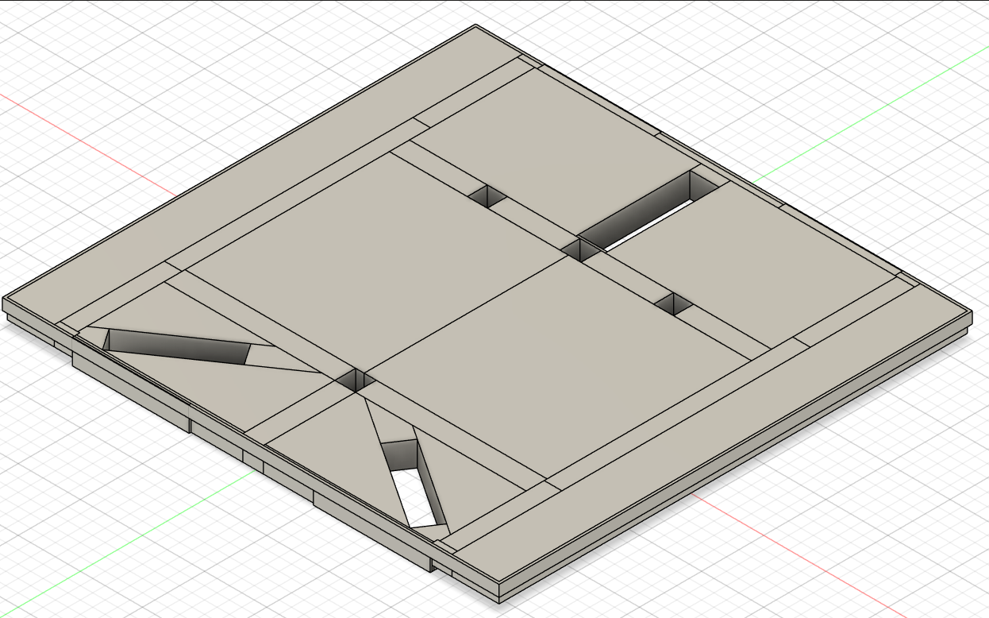
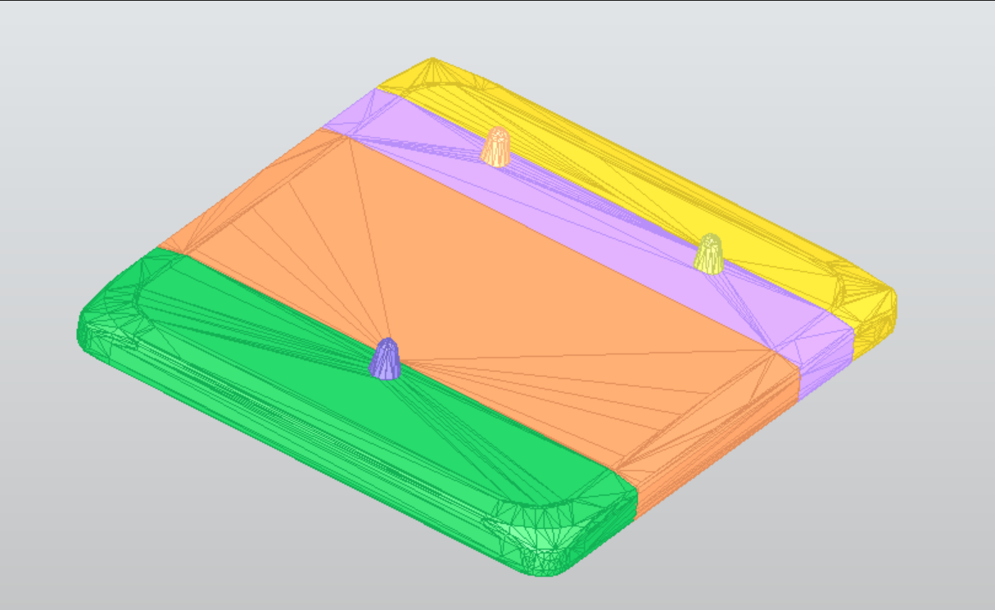
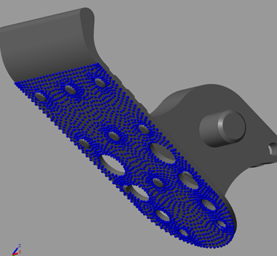
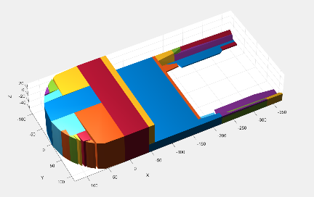
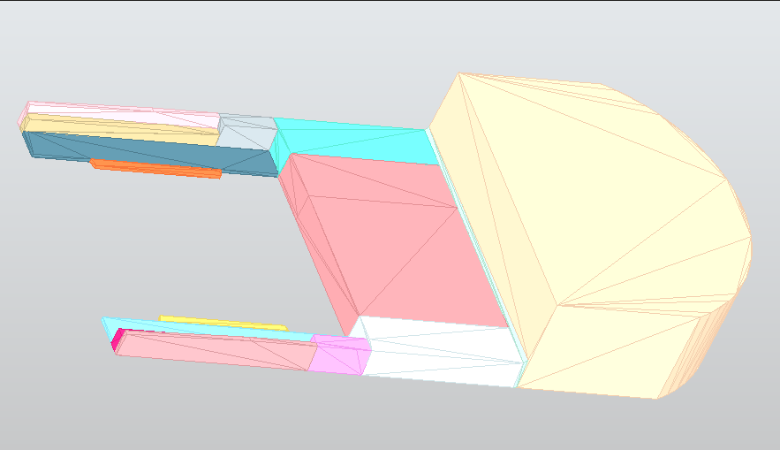
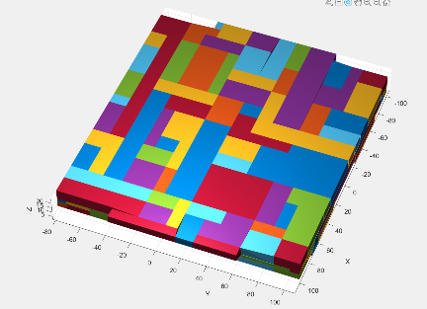
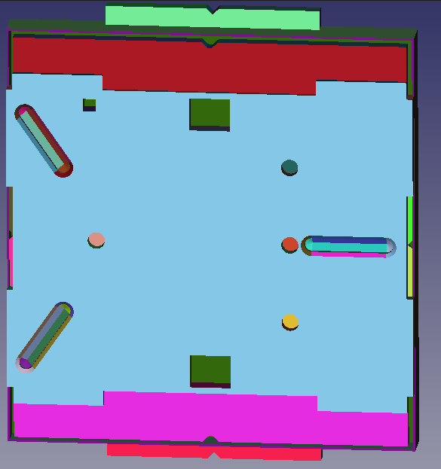
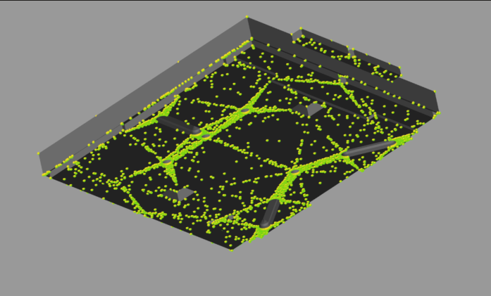
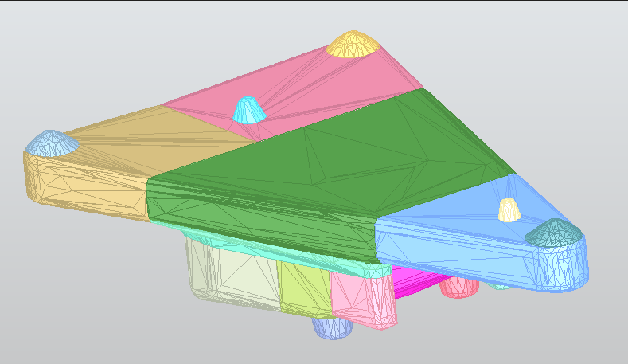
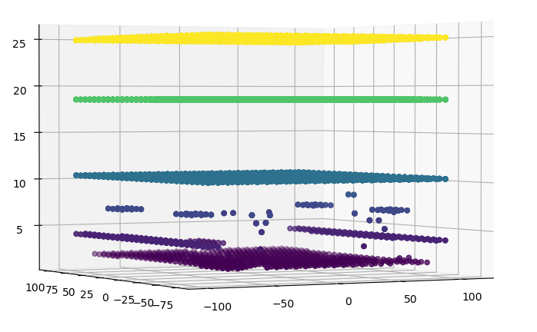
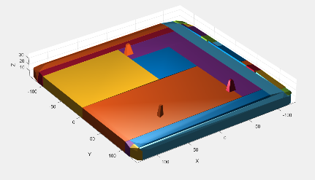
Collision Detection Pre-processing Solutions Evaluated
Approximate Convex Decomposition for 3D Meshes with Collision-Aware Concavity
Point Cloud Estimation for Surface Contact Modeling
V-HACD (Voxelized Hierarchical Approximate Convex Decomposition)
Manual Decomposition via CAD (Computer Aided Design)
2
4
1
3
December 2, 2025
Notes:
This leads me to the 4 possible solutions I evaluated when figuring out how to deal with this issue.
Option 1 was to use approximate convex decomposition which was a research paper released in 2022 by UCSD, I built an intensive python script around their algorithm to automatically decompose the shape based on baseline parameters I specified. Option 2 was to use a point cloud to estimate surface contact but this did not work too well because estimating the mass of a bunch of points in space can lead to some very complex issues down the line.
Option 3 is like option 1, using voxelized hierarchal approximate convex decomposition but as you can see from the images it did not product the simplest parts.
Option 4 is to manually hop into CAD and decompose the parts myself which can be tedious and time consuming. I ended up settling on option 1 and option 4, taking the best of both worlds to decompose my parts.

Slide 5
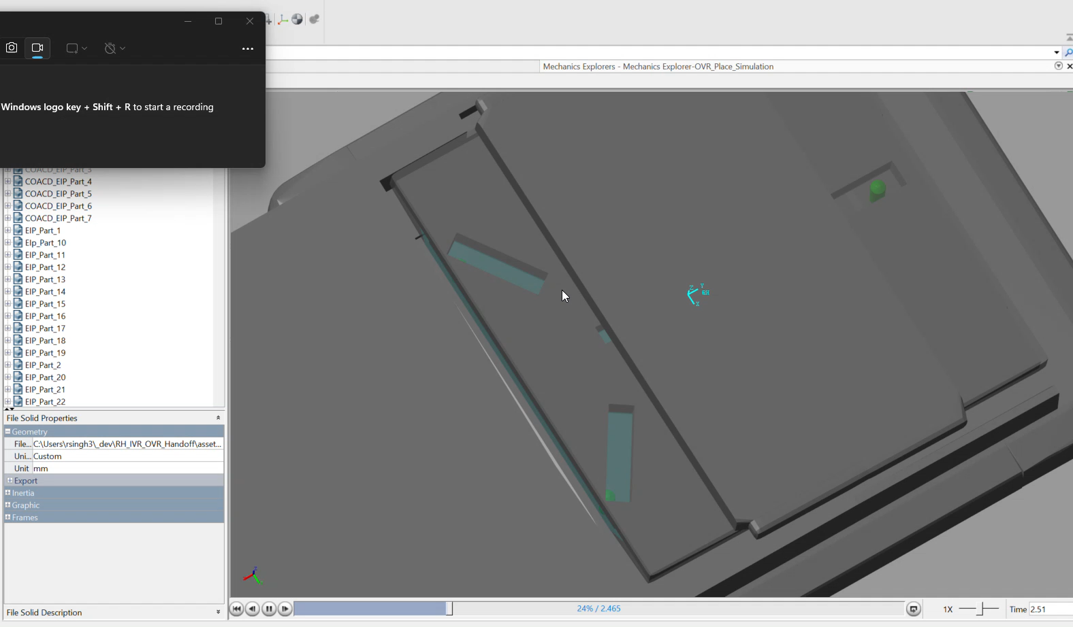
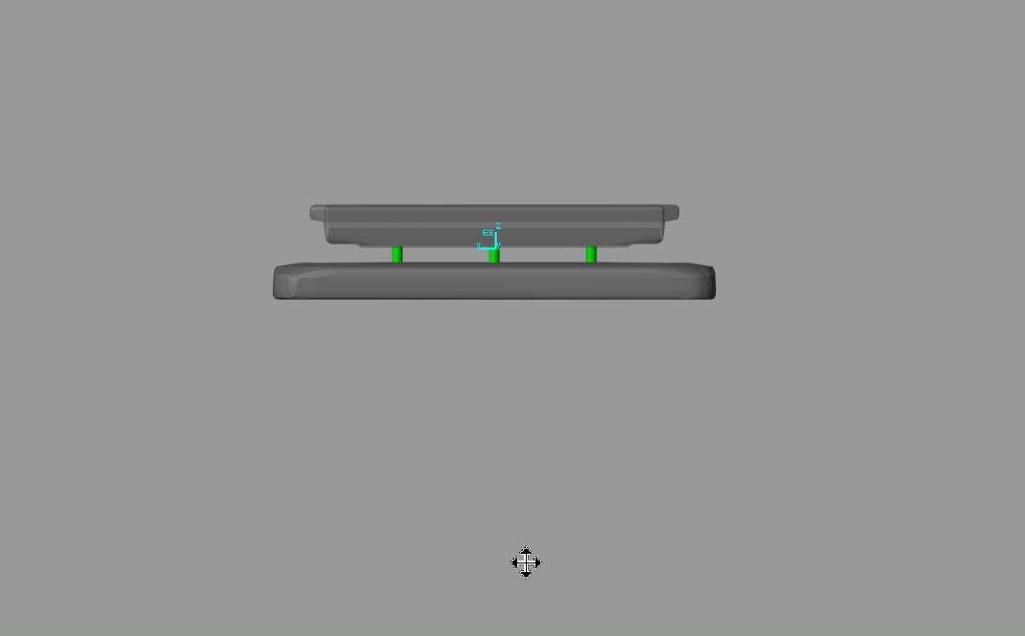
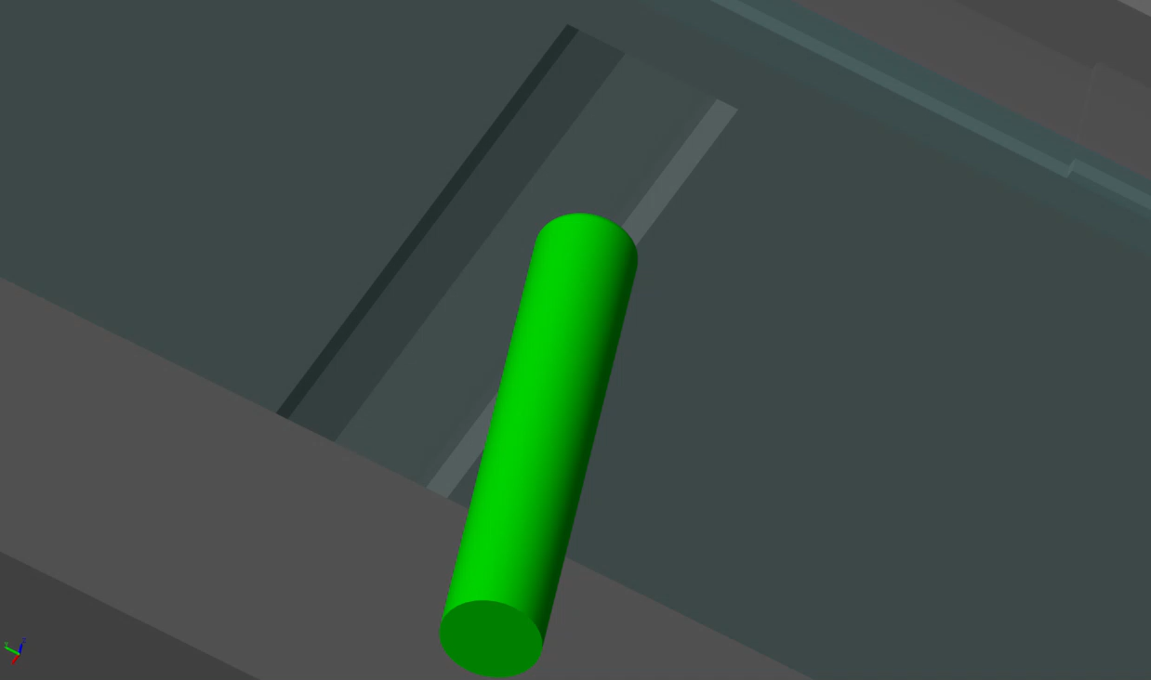
Project Progress & Future Objectives
3
Validated proof of concept: Kinematic pins successfully engage with the EIP, achieving realistic locking behavior.
Next steps in simulation:
Test various sensor placements and their impact on detection accuracy.
Introduce calibration errors to evaluate system robustness.
Vary gripper positions to identify tolerance thresholds for successful reticle handoff.
1
2
Notes:
After decomposing this pieces, I was able to get the first successful simulation running that was physics accurate and achieved realistic locking behavior. As you can see from the videos playing in the background the system is interlocking quite well and showing how the pin realistically slides into the allotted slots.
The next steps are to add sensors, introduce calibration errors and various gripper positions to see in what scenarios will this handoff fail.

Slide 6
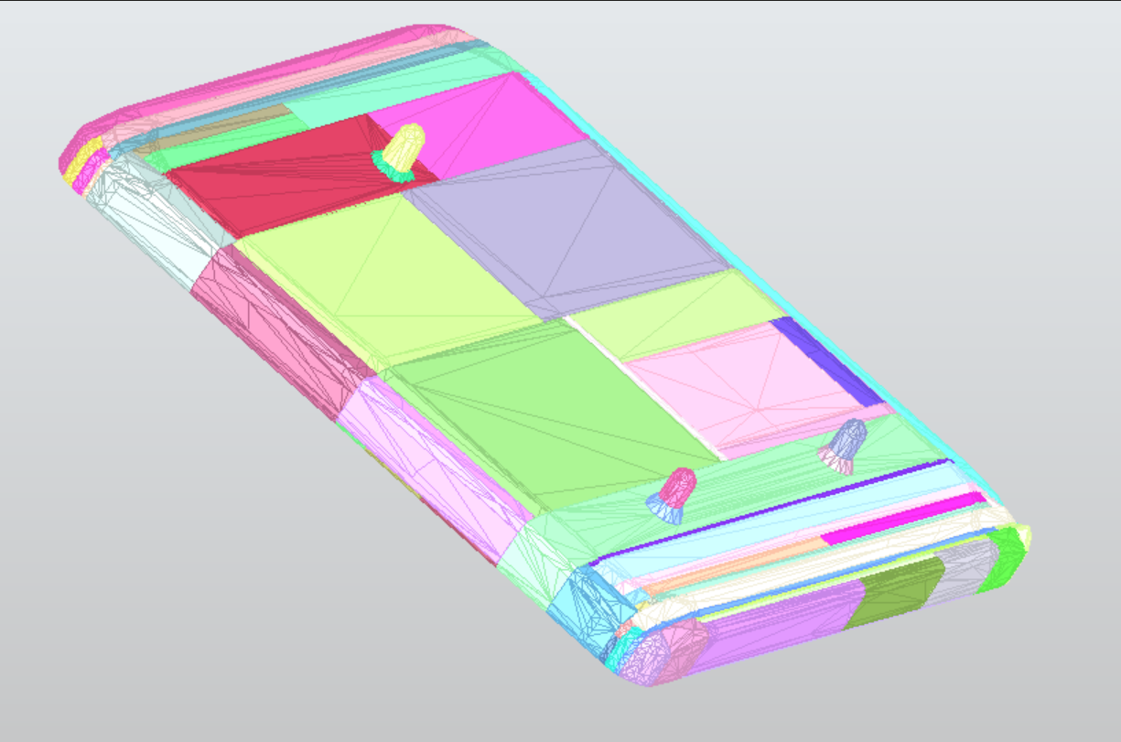
Thank you!
Rohan Singh
Wilton, CT
Reticle Handler Intern
rohan.singh-rmyo@asml.com
Notes:
Thank you! Any questions?

